Slide 1


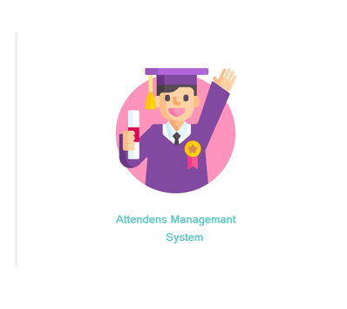


AMS
Computer – Based
Student Attendants Management System
ICT PROJECT 2024
PROJECT BY:-
E2410978
R.R.G.S.RAJAPAKSHA
Bachelor of Information Technology (External Degree)
Faculty of Information Technology University of Moratuwa

Slide 2

Content
01
02
03
04
05
06
07
INTRODUCTION
OBJECYIVES
SYSTEM TECHNOLOGY
FUNCTIONAL REQUIREMENTS
NON FUNCTIONAL REQUIREMENTS
USER INTERFACE
FUTURE DEVELOPMENT

Slide 3




INTRODUCTION
THIS PROJECT
Project Aim
The Student Attendants Management System is a computer application designed to streamline the essential administrative tasks of schools. It focuses on automating student registration, class management, attendance tracking, and reporting, reducing errors from manual methods
To provide a cost-effective, user-friendly, and centralized digital platform to replace manual paper record-keeping, ensuring data accuracy and improving administrative decision-making in resource-constrained schools.

Slide 4


The Problem I Found
  Manual processes use Paper Registers or basic spreadsheets.
  Methods are time-consuming and error-prone.
  Leads to high workload (Administrative Overload) for staff.
  Lack of real-time insights for administrators.
My Solution
  Deploy a Centralized Digital Platform for all records.
  Provide Secure Login with role-based access.
  Ensure Data Accuracy and consistency.
  Offers an Efficient Attendance marking module.

Slide 5





Objectives
Cost-Effectiveness Guarantee
Usability-First Design
Minimizes training time for non-technical users and supports deployment on low-cost, readily available infrastructure
Ensures long-term operational sustainability and adoption in financially limited environments.
AMS
Promote Digital Equity
Data-Driven Decisions
Provides administrators with timely, accurate intelligence to flag at-risk students and allocate resources effectively
Replaces failure-prone manual systems with a modern, streamlined solution, allowing educators to refocus on pedagogical delivery.

Slide 6


SYSTEM TECHNOLOGY
The system uses:
  Language: C#
  Framework: .NET Framework
  Database: MS SQL Server
  Deployment: Designed to be self-contained for easy local deployment in resource-limited environments.

Slide 7


FUNCTIONAL REQUIREMENTS
  Login & Security: User authentication via secure login with Role-Based Access (Admin/Teacher).
  Reporting: Generate standardized Attendance Summary Reports for administrators.
  User Management: Allow Admins to manage system users (teachers and other admins).
  Student Management: CRUD operations (Create, Read, Update, Delete) for Student and Class records.
  Attendance: Allow teachers to rapidly mark daily attendance and save records with integrity (transactions).
.

Slide 8
NON FUNCTIONAL REQUIREMNTS
  Usability: Highly user-friendly interface with minimal training required.
  Performance: Fast response time for attendance marking (e.g., loading students).
  Security: Data protection (e.g., password hashing) and restricted access based on user role.
  Maintainability: Code must be easily updated and maintained for future features.
  Reliability: The system must ensure high data accuracy and integrity (e.g., through database transactions).

Slide 9

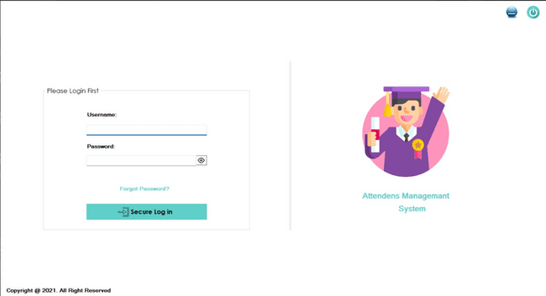
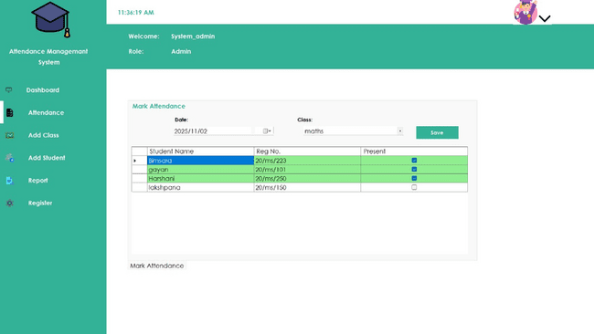
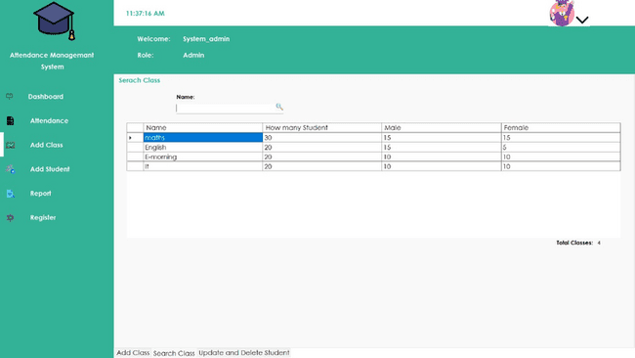
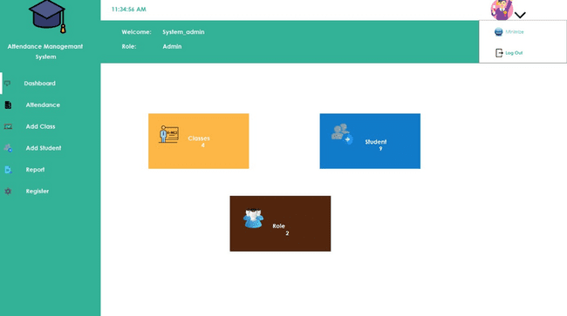
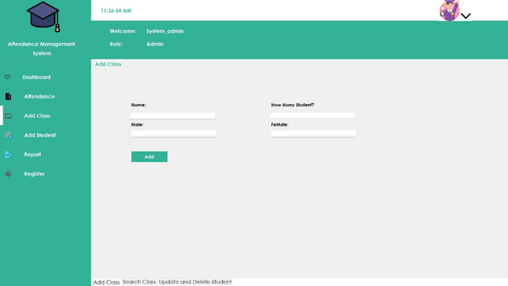
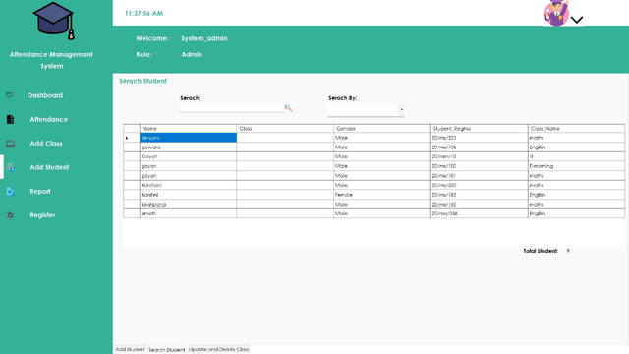
USER INTERFACE

Slide 10


Future Improvements
Expanded Reporting
Introduce more complex reports like attendance rate history and trend analysis.
Communication Module
Integrate features for sending automated notifications/alerts to parents regarding student absenteeism.
Mobile Access
Develop a mobile-friendly interface for even easier attendance marking by teachers in the classroom.
Cloud Deployment
Explore scalable, low-cost cloud deployment options to enhance accessibility and centralized governance.

Slide 11

THANK YOU
For Your Attention
Contact : E2410978@bit.com.lk
gayansanjeewa@gmail.com

